Slide 1

Careers in data science by salary
Lucas chacon, ryan dekker, alena Matusevich, and Lillian Ruelas-thompson
1.22.24

Slide 2

Overview
Database: MongoDB
Data Source: Kaggle
We used: Pandas, PyMongo, Python
New libraries used: Seaborn (Data clean-up), Bokeh (Interactivity), statsmodels (linear model)
Purpose: To describe salary trends in data-related careers
About Data:
9355 rows by 12 columns
Has a short description of each column
Data provides information from 2020-2023
Data also includes information from other countries, as well as data from salary by country currency
LOOKING AHEAD

Slide 3

Limitations of the data
We don't know how the data was collected. Was it directly obtained from the companies or from scraping job search websites?
No description of each job category. We don't know the reasons for each job title to be placed in a specific category. Was this decision peer-reviewed?
Some job titles such as Junior Data Analyst are not included
Experience level categories 'Entry-level', 'Mid-level', 'Senior', and 'Executive' are not defined.
Likewise, the data are skewed towards "Senior" positions, with far more than Entry, Mid-level, and Executive levels combined...
Company size categories 'L', 'M', 'S' are not defined
The data are skewed heavily towards "Medium" sized companies, which may weaken claims about comparisons to Large and Small companies
There is no information for employee education or degree
Coded for region of the U.S. would also be helpful
There is no information for State for USA company location and employee location
Very few “Hybrid” workers in this dataset
Data is not diverse by country. About 85% of the data has the US listed as the country.
The data is not broken down by state within the US, so it is unclear how the salaries range by state.

Slide 4
Process
Data Clean-up |  |  | Exploration |  |  | Analysis |  |  | Visualizations
Clean-up of data was done with a new library, Seaborn. |  |  | Due to skewed data, and to make sure data was informational to our audience, we only focused on Full-time positions in the US for the 2023 year and removed Hybrid positions for lack of data. |  |  | Analysis for the proposed questions were done using PyMongo. |  |  | Visualizations were created with a new library, Bokeh.
4

Slide 5
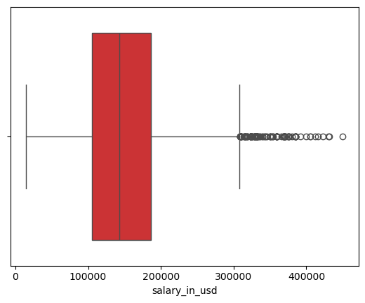
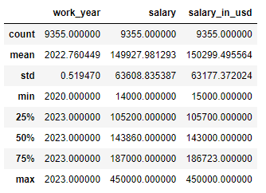
Data clean-up
Data Cleanup Steps:
# Check data size and type
data.info()
# Check for null values per column
data.isnull().sum()
# Check for N/A values per column
data.isna().sum()
# Get summary statistics
data.describe()
Note: Seaborn Python Library was used to create plots
import seaborn as sns
# Create salary_in_usd box plot to check for outliers
sns.boxplot(x=data['salary_in_usd'], palette = "Set1")
# Explore outliers with high salary
data_sorted.head(20) # executives or seniors in R&D jobs
# Explore outliers with low salary
data_sorted.tail(20) # part-time or low cost GEOs jobs
# Duplicates: No need to check for duplicates because there is no unique column or ID column.
Data cleanup conclusion: jobs_in_data.csv data is clean because every cell has a value with correct data type per each column. Also there is not any duplicates or outliers.

Slide 6
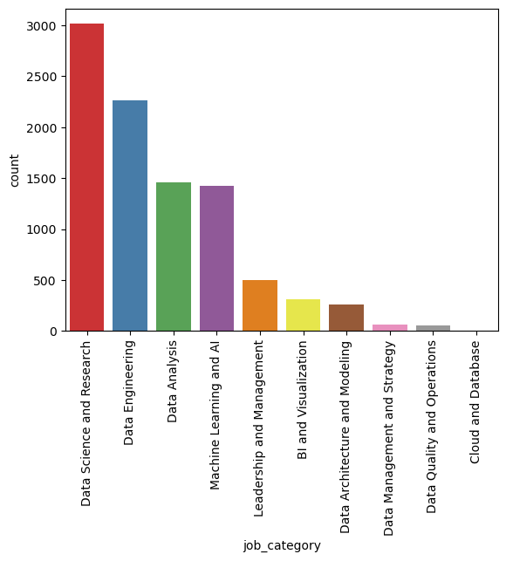
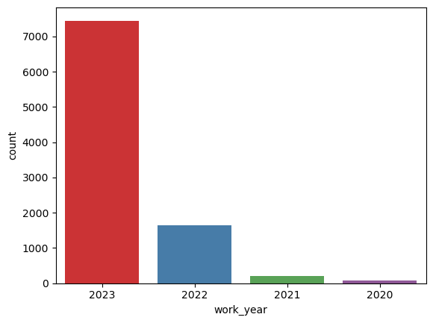
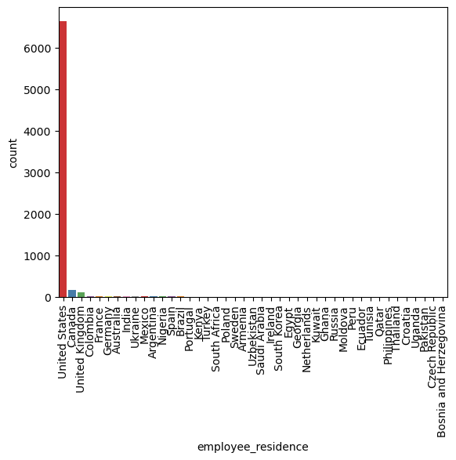
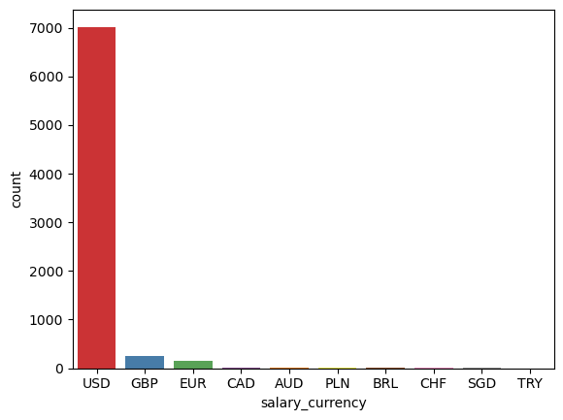
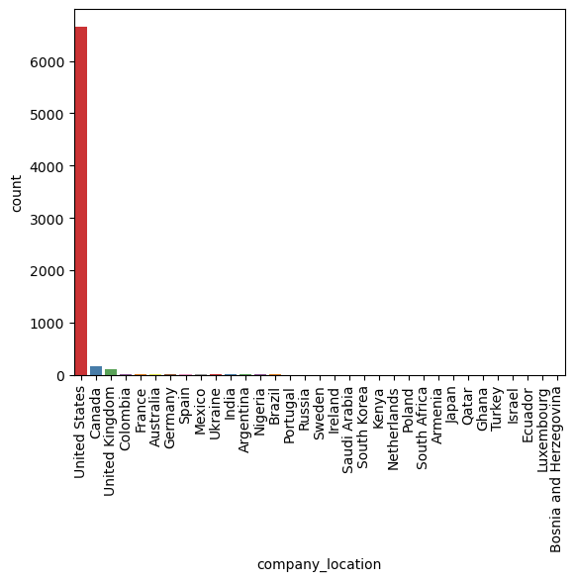
Data exploration & Preparation P1
# Plot the number of rows per job_category
# Plot the number of rows per year # Plot rows per employee_residence
# Plot rows per currency # Plot rows company_location
# Calculate number of unique job titles
data['job_title'].value_counts().size = 125
# Count unique job tittles per job category
data.groupby(['job_category'])['job_title'].nunique().sum() = 125
Thus, each job title appears once per job category.
Keep: both job_category and job_title columns.
Note: Seaborn Python Library was used for plots
Drop Rows: work_year rows ! = 2023.
Drop Rows: salary_currency rows != USD
Keep: salary column with salary values in USD
Drop Rows: employee_residence and company_location rows != US Drop Columns: work_year , salary_currency, salary_in_usd, employee_residence and company_location due to the lack of information

Slide 7
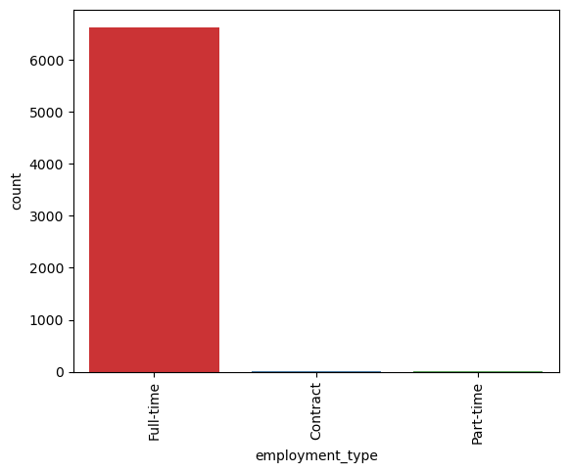
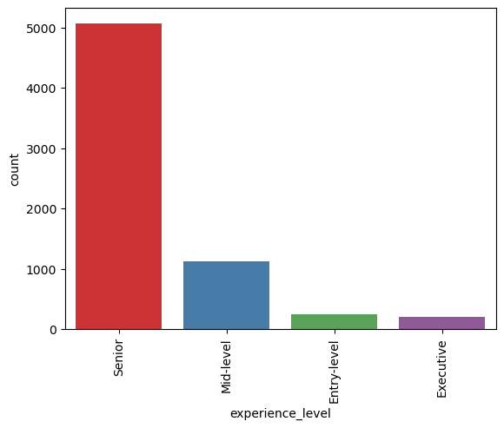
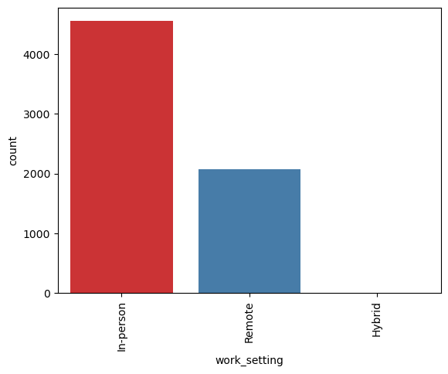
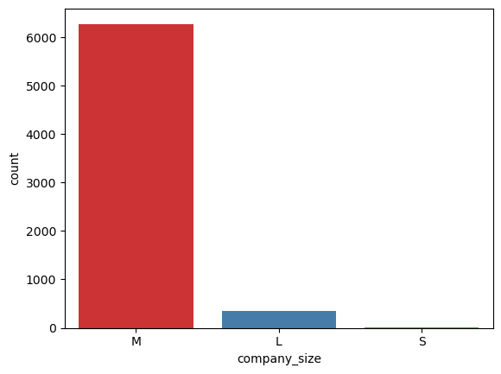
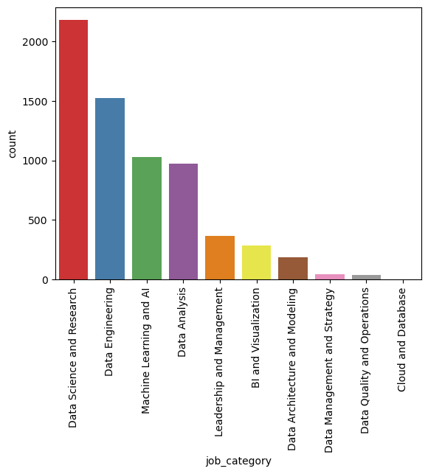
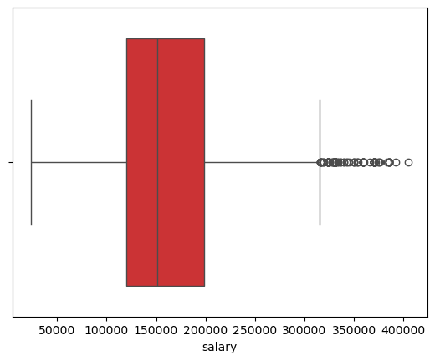
Data exploration & Preparation P2
# Rows per employment_type # Rows per experience_level # Rows per work_setting #Rows per company_size
Drop: employment_type rows != Full-time , then drop employment_type column
Keep: experience_level, work_setting and company_size rows with all the data
Final DF summary:
Number of columns reduced from 12 to 6
Number of rows reduced from 9355 to 6635
Number of job_titles reduced from 125 to 78
Number of job categories remained 10 or the same
Kept data for:
Year 2023
US full-time employees
US company location

Slide 8

analysis
What is the salary difference between company sizes?
Salary differences by company size:
S - M: $-15,210.06
S - L: $-26,223.97
M - L: $-11,013.91

Slide 9

analysis
What is the difference in salary by work setting?
Salary differences by work setting:
In-person - Remote: $6599.07

Slide 10


analysis
What is the average salary based on the job title and work experience?
How does job category affect salary between job titles?
End of fiscal celebration on July 15th
Employee day of learning on August 14th
Employee Yoga on September 3rd
Seminar series begins September 10th
Increase customer satisfaction by 2%
Maintain growth
Initiative partnership with 3rd party organizations

Slide 11

Data Visualization
Let’s Dive In

Slide 12

Explore JOB Category
Machine Learning and AI ['Machine Learning Researcher' 'Machine Learning Engineer' 'Machine Learning Scientist' 'AI Engineer' 'MLOps Engineer' 'ML Engineer' 'Machine Learning Modeler' 'AI Developer' 'AI Architect' 'Computer Vision Engineer' 'Machine Learning Infrastructure Engineer' 'Machine Learning Software Engineer' 'Head of Machine Learning' 'Deep Learning Engineer' 'NLP Engineer' 'Applied Machine Learning Engineer' 'Applied Machine Learning Scientist']
BI and Visualization ['BI Developer' 'Business Intelligence Engineer' 'Business Intelligence Analyst' 'BI Analyst' 'Business Intelligence Manager' 'Business Intelligence Developer' 'Business Intelligence Specialist' 'Data Visualization Specialist' 'Data Visualization Engineer' 'Data Visualization Analyst'] Cloud and Database ['Cloud Database Engineer'] Data Analysis ['Data Analyst' 'Financial Data Analyst' 'Business Data Analyst' 'Compliance Data Analyst' 'Business Intelligence Data Analyst' 'Lead Data Analyst'] Data Architecture and Modeling ['Data Architect' 'Data Modeler' 'Data Strategist' 'AWS Data Architect'] Data Engineering ['Data Engineer' 'Data Integration Engineer' 'ETL Developer' 'Data Infrastructure Engineer' 'Software Data Engineer' 'BI Data Engineer'] Data Management and Strategy ['Data Management Analyst' 'Data Specialist' 'Data Integration Specialist’ 'Data Management Specialist' 'Data Strategy Manager'] Data Quality and Operations ['Data Quality Engineer' 'Data Quality Analyst' 'Data Operations Analyst ''Data Operations Engineer' 'Data Operations Manager' 'Data Operations Specialist'] Data Science and Research ['Data Scientist' 'Applied Scientist' 'Research Scientist' 'Research Analyst' 'Research Engineer' 'Data Science Engineer' 'Data Science Consultant' 'Data Science Director' 'Data Science Practitioner' 'Data Science Manager' 'Decision Scientist' 'Director of Data Science' 'Principal Data Scientist' 'Data Science Lead' 'Head of Data Science'] Leadership and Management ['Analytics Engineer' 'Data Product Manager' 'Data Manager' 'Head of Data' 'Data Lead' 'Data Analytics Manager' 'Data Developer' 'Data Analytics Specialist']

Slide 13
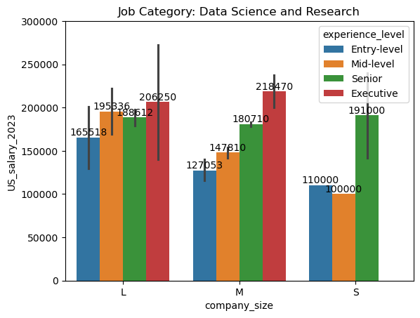
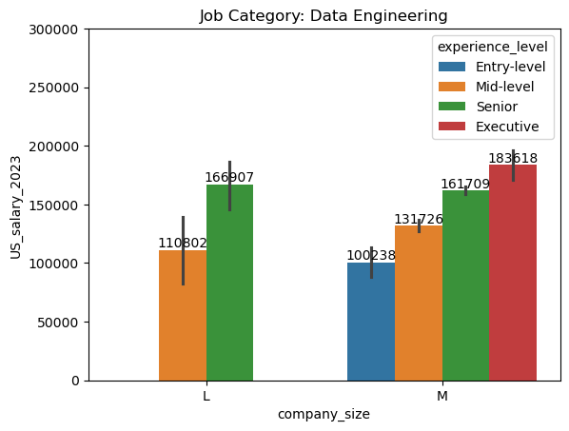
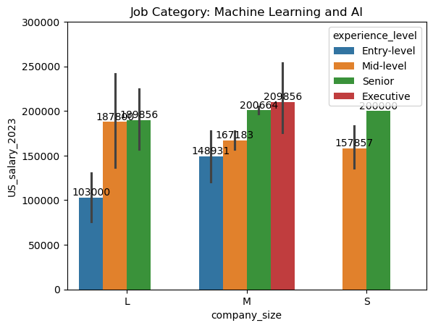
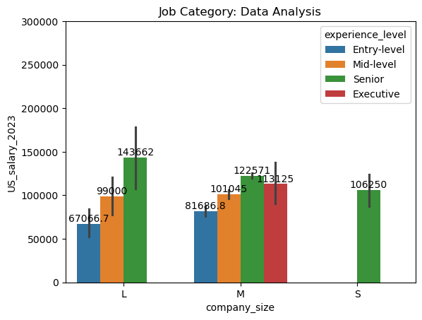
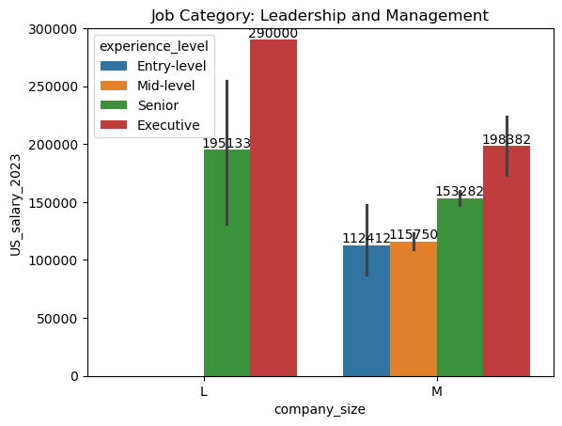
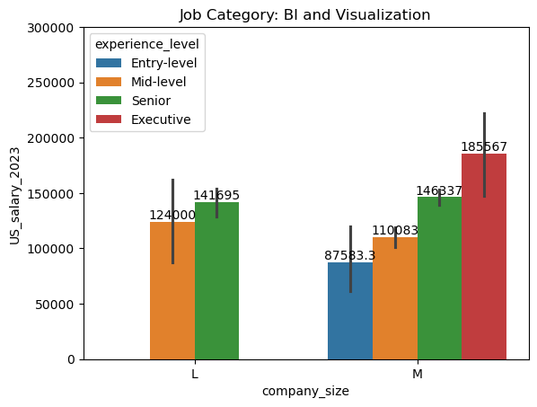
Salary per JOB category & Company Size
There is a noticeable difference in pay between the job categories and some difference in pay for company size.

Slide 14
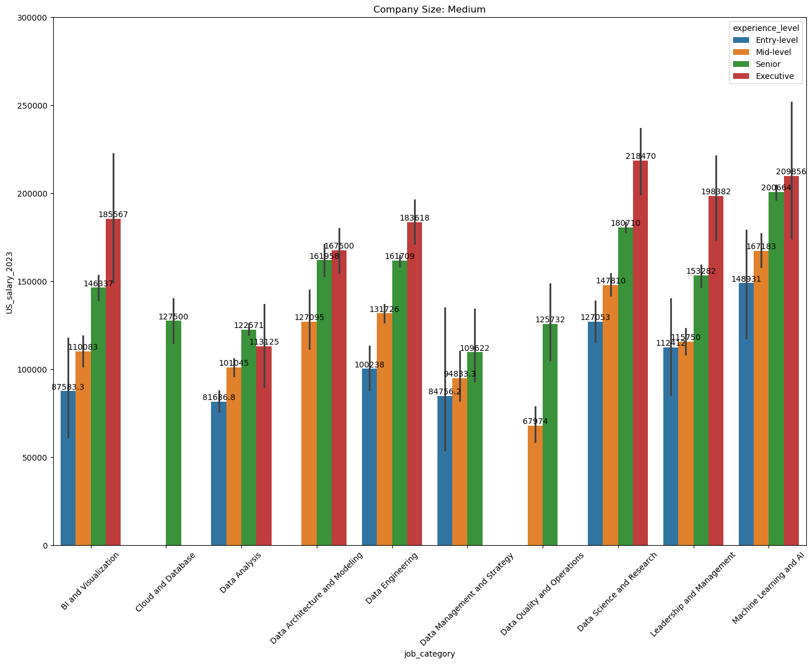
Salary per JOB category FOR medium Company
About 90% of data is for medium size company.
Tops 3 highest paying job categories: Machine Learning and AI, Leadership and Management &
Data Science and Research

Slide 15
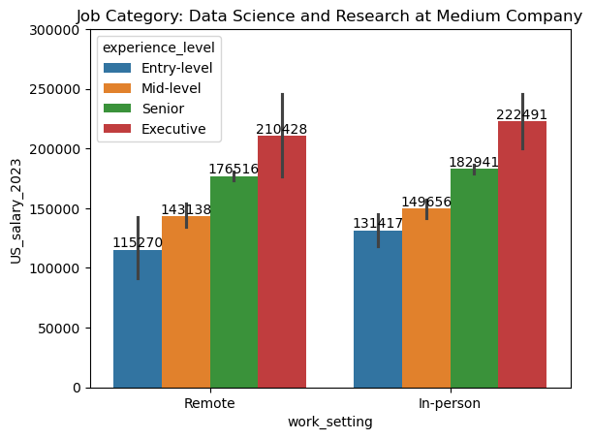
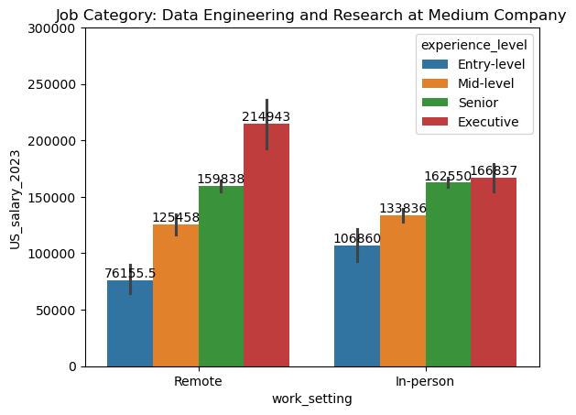
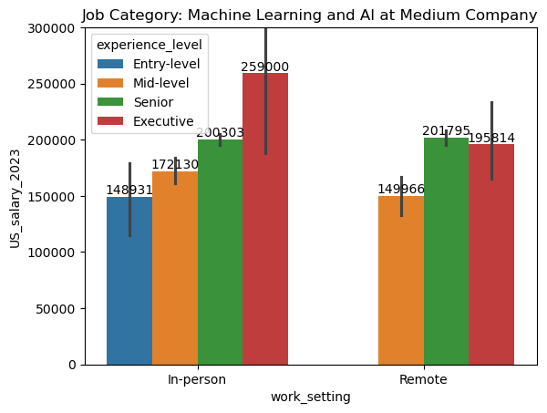
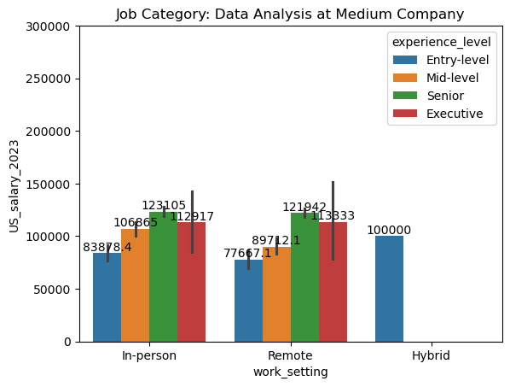
Salary per Work setting FOR medium Company
About 90% of data is for medium size company.
In general, in-person positions pay more than remote positions.

Slide 16
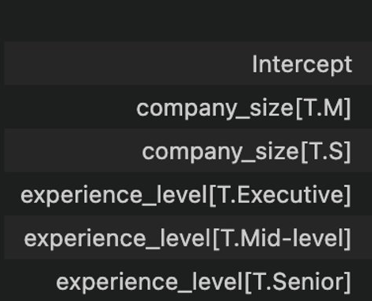
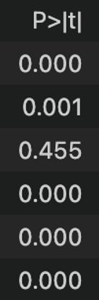
Do Company Size and title Matter?
Using a linear model, we can see if these factors are significant predictors looking at p-values
statsmodels package
<-- p-values are miniscule, showing that these factors are important

Slide 17
Do Company Size and title Matter?
 | Coef |  | Group | Modeled salary
Intercept (Entry-Large) | 120784 |  | Large-Entry | $120,784
company_size[Medium] | -16368 |  | Large-Mid-level | $169,143
company_size[Small] | -10784 |  | Large-Senior | $173,870
experience_level[Executive] | 113383 |  | Large-Executive | $234,167
experience_level[Mid-level] | 48359 |  | Medium-Entry | $104,416
experience_level[Senior] | 53086 |  | Medium-Mid-level | $129,740
company_size[Medium]:experience_level[Executive] | -26202 |  | Medium-Senior | $168,491
company_size[Medium]:experience_level[Mid-level] | -23035 |  | Medium-Executive | $131,300
company_size[Small]:experience_level[Mid-level] | -7734 |  | Small-Entry | $110,000
company_size[Medium]:experience_level[Senior] | 10989 |  | Small-Mid-level | $150,625
company_size[Small]:experience_level[Senior] | -19228 |  | Small-Senior | $139,131
Explores interaction effect ... whether experience level is treated differently across company sizes

Slide 18
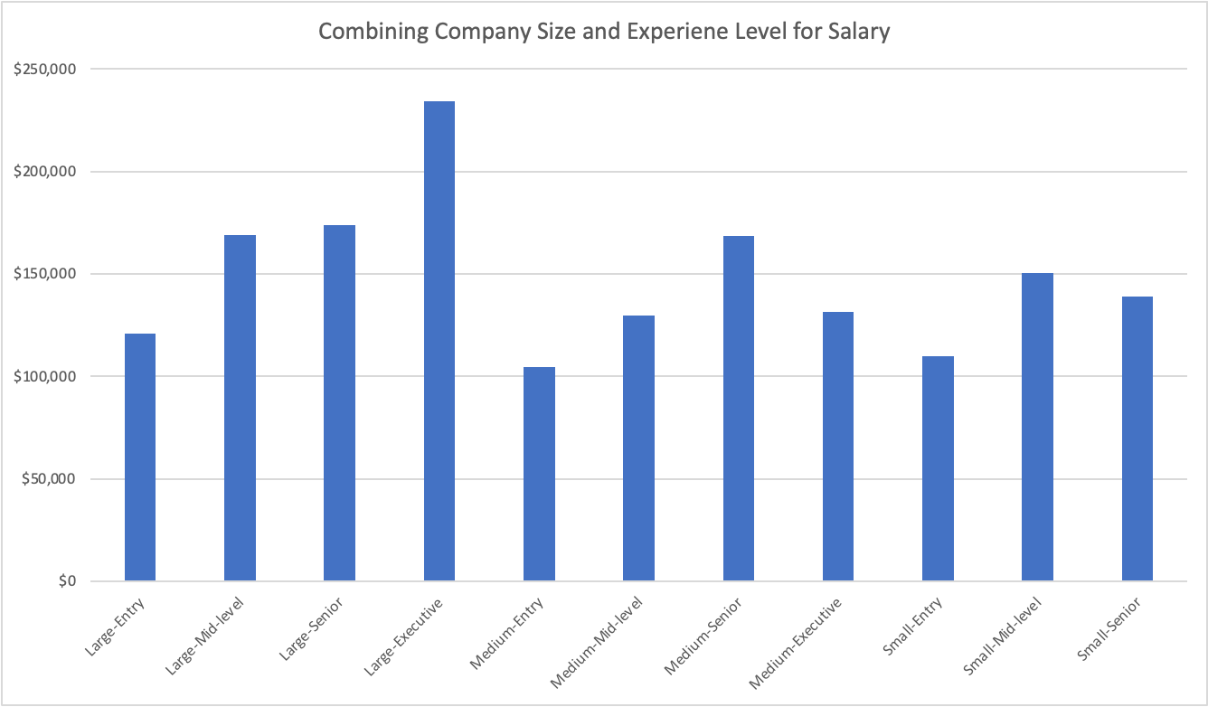
Company Size and title - Modeled

Slide 19
COMPANY SIZE AND TITLE - MODELED
Key technical talent (Senior) make more money at medium firms than their Executives!
Climbing the corporate ladder
¯\_(ツ)_/¯

Slide 20
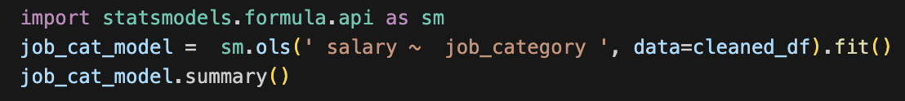
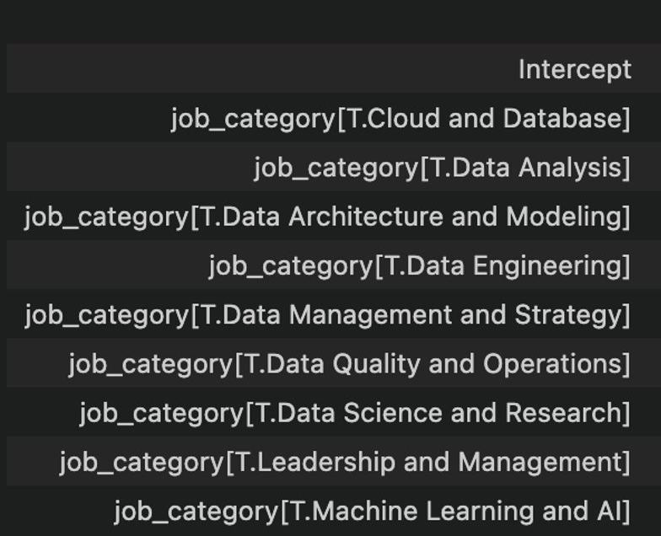
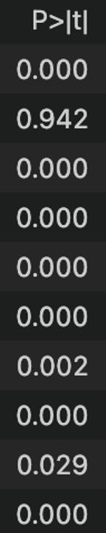
A Linear model for Job category
Using a linear model, we can see if this factor is significant predictors looking at p-values
<-- Cloud & Database not significant because too small a sample size
<-- all other p-values are miniscule, showing that these factors are important

Slide 21
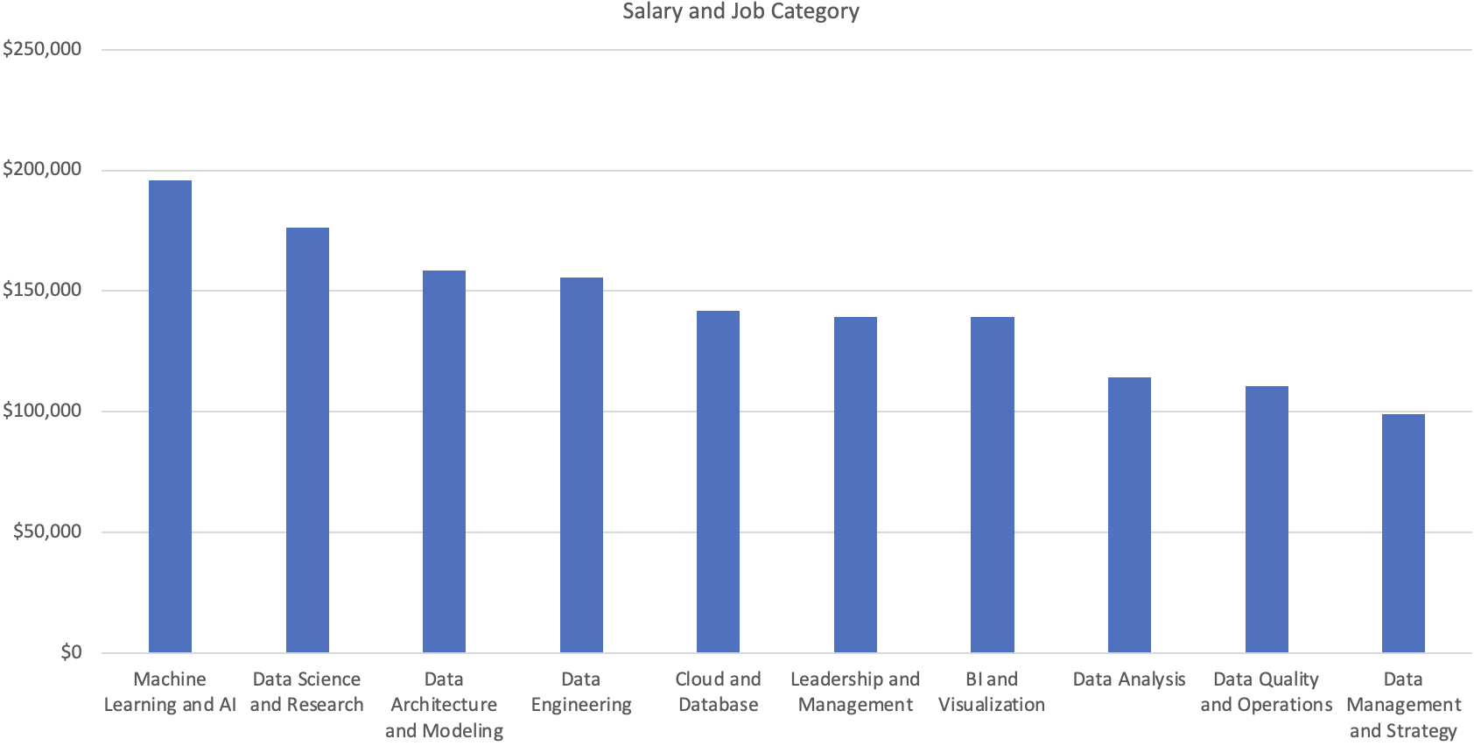
Job category - modeled

Slide 22
Job category - modeled
Over $150k – R&D focused
All approx. ~$140k, still very skilled
"Foot in the door"

Slide 23

SUMMARY
The wide spread of salaries job titles meant they were an important explanatory factor explaining
Surprisingly, at mid-range companies, Executives made less than Senior level employees
Paying top dollar to keep top technical talent...
Unsurprisingly, large firms paid more than the Medium and Small companies
In-person employees averaged ~$162k, which was higher than the remote employees ~$156k
Especially important for Entry-level

Slide 24
Questions?

